Slide 1
Getting Started with GIT

Slide 2
Notes
We are just getting going, and we are going to do it in small steps.
We are going to focus on the command line.
what we will learn to day will get you rolling, but is not sufficient for you to work professionally with GIT in a team.
For the time being use the githiub GUI to see changes over time e.g. comparing changes to files over time.

Slide 3
Repositories
A repository is a collection of files that need version control
Repositories can be crudely said to be “public” or ”private”, at least from the GitHub™ perspective.
GIT is a distributed version control tool
GitHub™ is a business, we are just using it as a free tool to get you started with. You can use it to augment your resume.

Slide 4
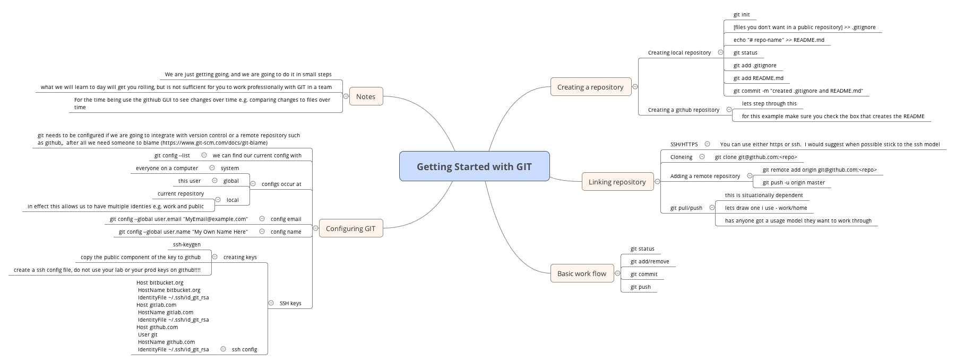
Getting Started with GIT

Slide 5
Configuring GIT
git needs to be configured if we are going to integrate with version control or a remote repository such as GitHub™, after all we need someone to blame (https://www.git-scm.com/docs/git-blame)
We can find our current config with
  git config –list
Two particular config elements need to be configured before we can link repositories
  config email: git config --global user.email "MyEmail@example.com"
  config name: git config --global user.name "My Own Name Here”
Configs can exist at system/global/local levels.
SSH keys

Slide 6
configs
System – everyone on a computer
Global – a user
Local – a repository
In effect this allows us to have multiple identies e.g. work and public for example.

Slide 7
creating keys
ssh-keygen
Create a ssh config file, do not use your lab or your prod keys on GitHub™!!!!
$ cat ~/.ssh/config
Host bitbucket.org
Copy the public component of the key to GitHub™
HostName bitbucket.org
IdentityFile ~/.ssh/id_git_rsa
Host gitlab.com
HostName gitlab.com
IdentityFile ~/.ssh/id_git_rsa
Host github.com
User git
HostName github.com
IdentityFile ~/.ssh/id_git_rsa

Slide 8
Creating local repository
git init
[files you don't want in a public repository] >> .gitignore
echo "# repo-name" >> README.md
git status
git add .gitignore
git add README.md
git commit -m "created .gitignore and README.md"

Slide 9
Creating a GitHub™ repository
lets step through this
for this example make sure you check the box that creates the README

Slide 10
Linking repository
SSH/HTTPS: You can use either https or ssh. I would suggest when possible stick to the ssh model
Cloning:
  git clone git@github.com:<repo>
Adding a remote repository
  git remote add origin git@github.com:<repo>
  git push -u origin master
git pull/push

Slide 11
A basic work flow
git status
git add/remove
git commit
git push

